Slide 1
Diabetes Classification Using Logistic Regression
Notes:
GITHUB LINK: https://github.com/desoura/diabetes_model

Slide 2
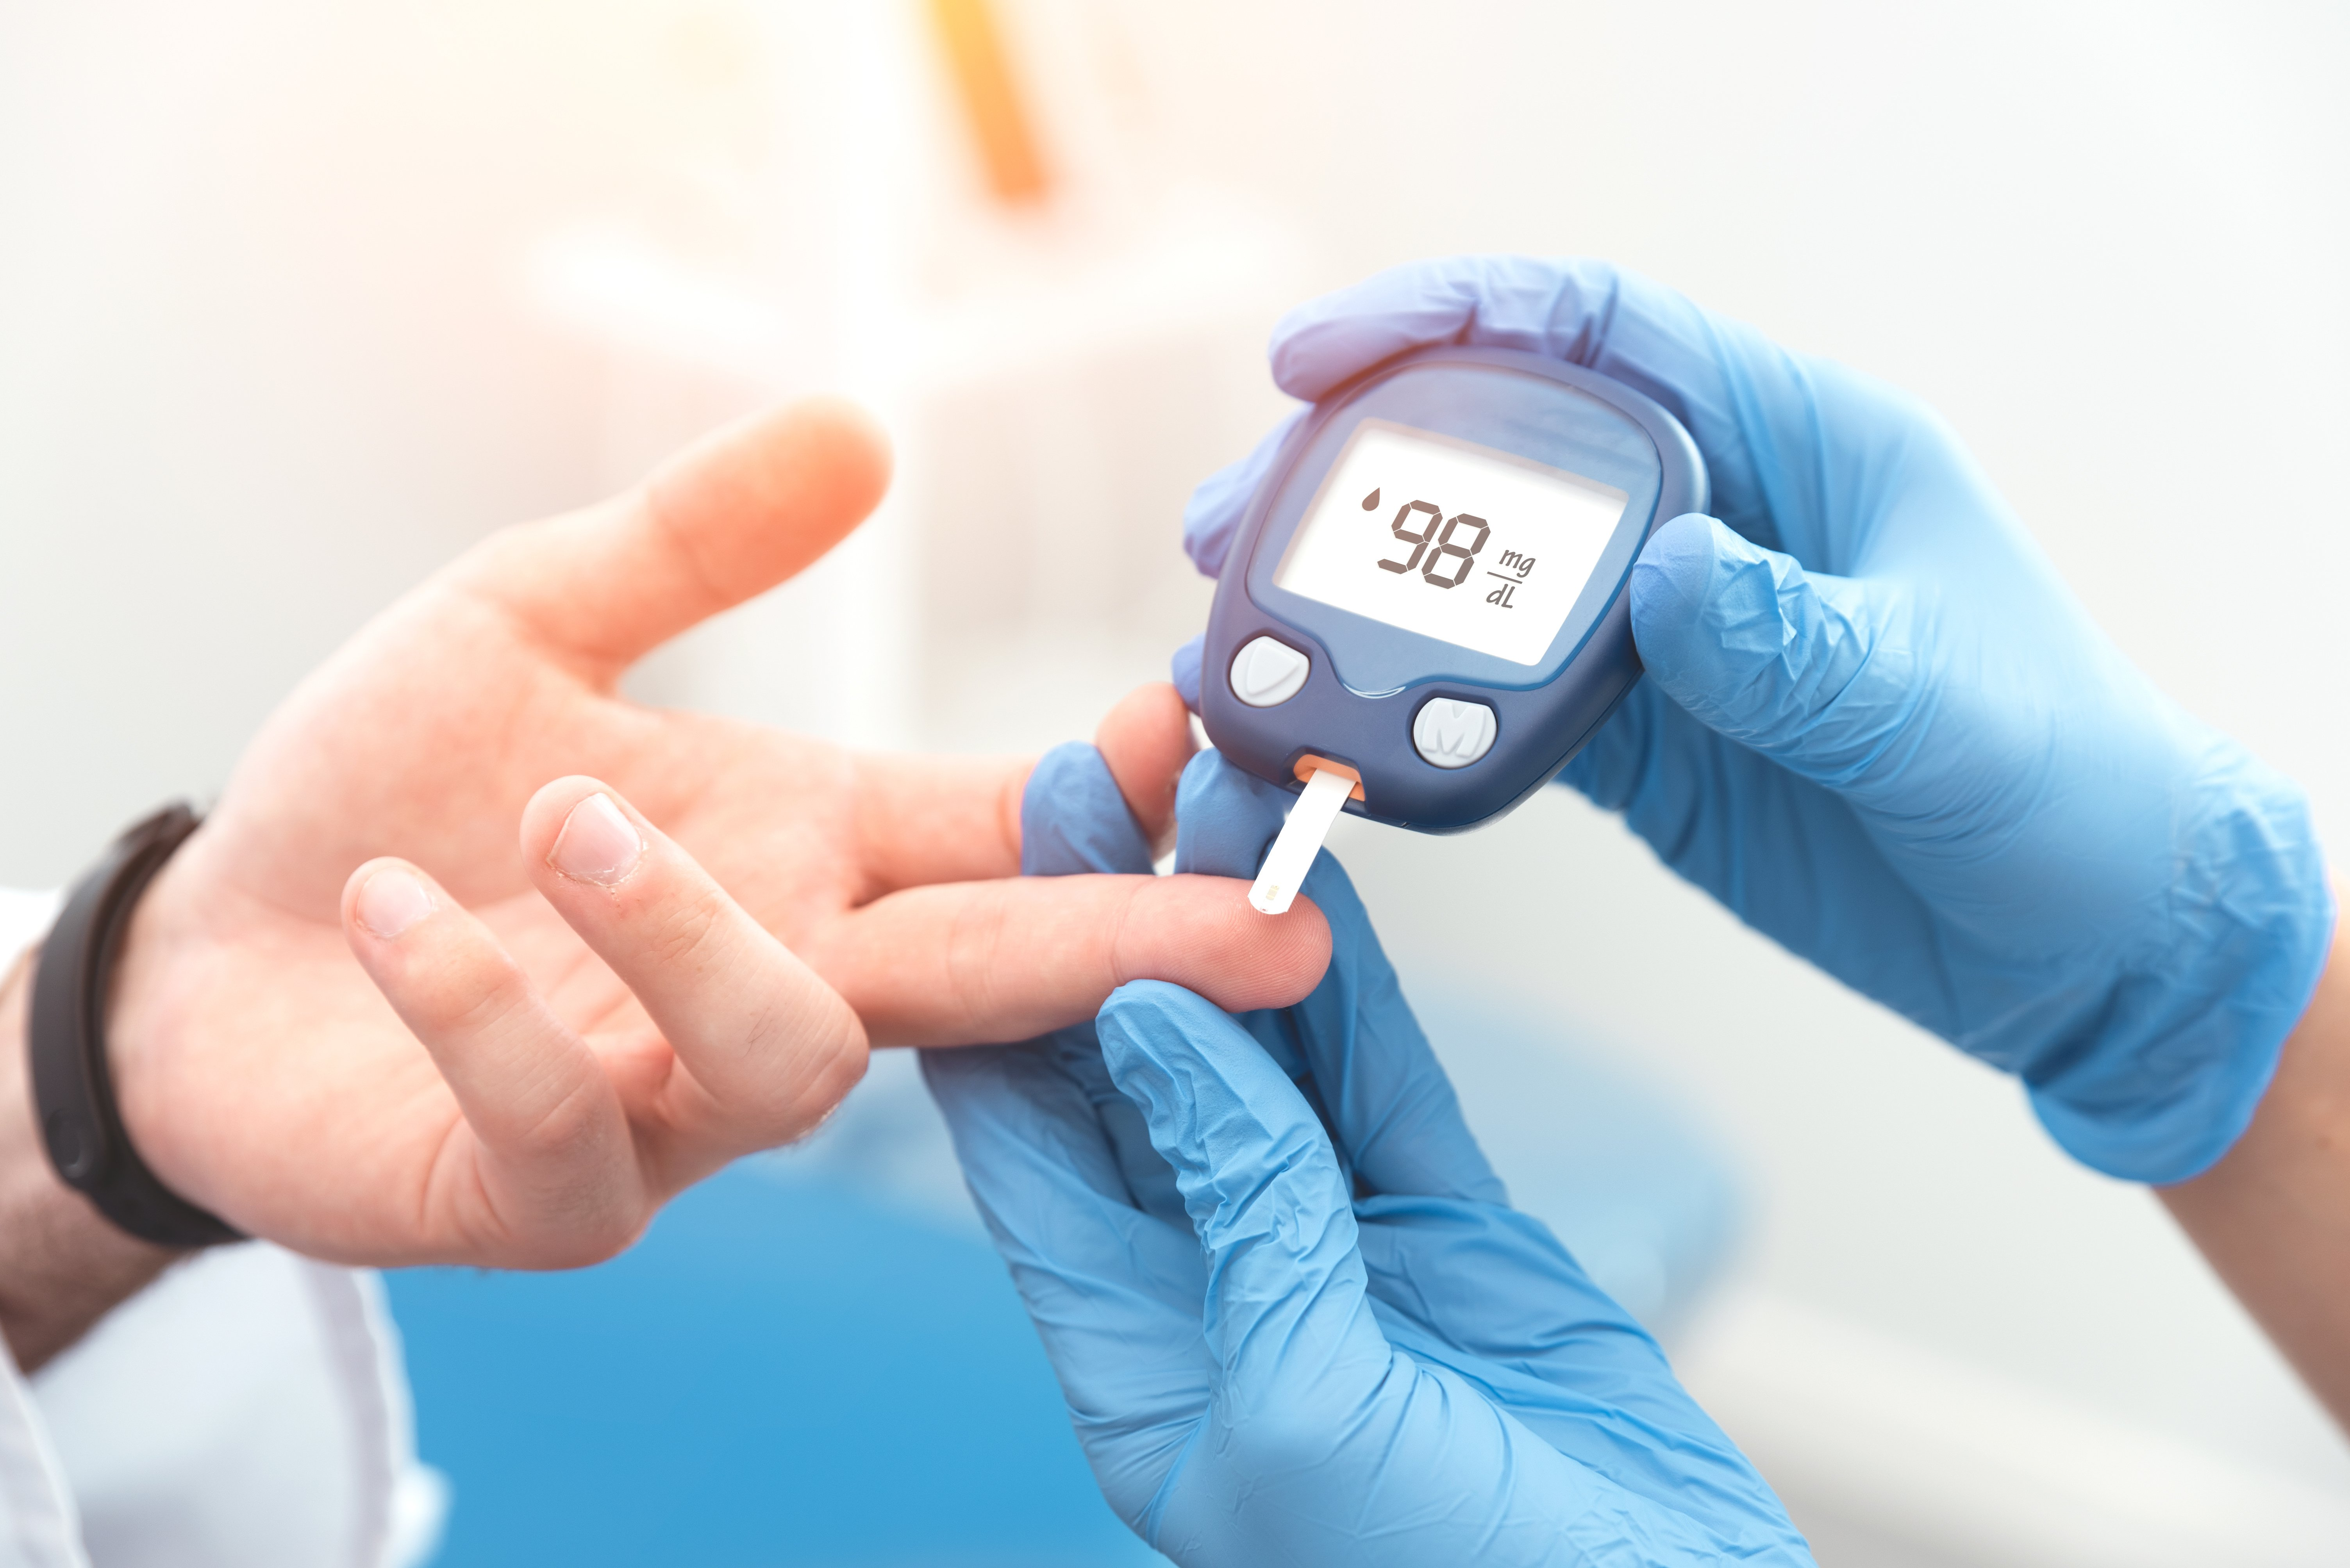
What is Diabetes?
Diabetes mellitus is a disease that occurs when your blood sugar is too high.
There are three main types: Type I, Type II, and Gestational Diabetes.
Prevalence: In 2021, over 500 million adults had diabetes worldwide. In the US, nearly 40 million Americans had diabetes.
In 2019, diabetes and kidney disease (due to diabetes) caused an estimated 2 million deaths worldwide.
Sources:
https://www.niddk.nih.gov/health-information/diabetes/overview/what-is-diabetes
https://www.who.int/news-room/fact-sheets/detail/diabetes
https://diabetes.org/about-diabetes/statistics/about-diabetes
https://diabetesatlas.org/#:~:text=Diabetes%20around%20the%20world%20in%202021%3A,%2D%20and%20middle%2Dincome%20countries.
Notes:
Symptoms include: increased thirst, frequent urination, blurred vision, tiredness, and unintentional weight fluctuations.
Diabetes can increase the risk for damage to the eyes, kidneys, nerves, and heart. Diabetes is even linked to some types of cancer.

Slide 3

Why is Diabetes Research Important?
In 2021, it was estimated that nearly 240 million adults living with diabetes were not diagnosed worldwide.
Individuals who are diagnosed later in life are more likely to use more healthcare services due to a greater likelihood of diabetes complications.
Type II diabetes is largely preventable or manageable through lifestyle changes.
Screening and diagnostic tests are urgently needed, particularly in areas that have insufficient access to healthcare or healthcare resources.
Sources:
https://www.ncbi.nlm.nih.gov/books/NBK581940/
https://www.niddk.nih.gov/health-information/diabetes/overview/preventing-type-2-diabetes
Notes:
Greater use of hospitals = placing additional burden on a healthcare system.

Slide 4
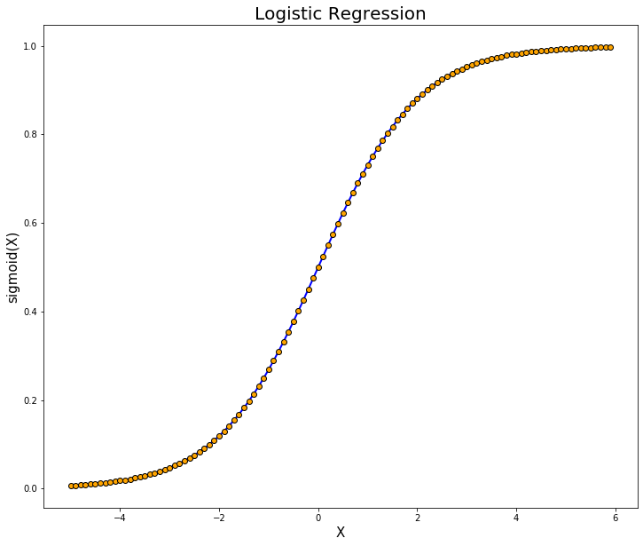
The Approach: Logistic Regression
Machine learning methods for screening and diagnosis are relatively cost-effective methods for detecting diabetes.
Clinicians and healthcare professionals can use screening tools to supplement their expertise.
Logistic regression: a machine learning model primarily used for classification.
Using clinical data, a logistic regression model will make predictions for two classes (Diabetes vs. No Diabetes).

Slide 5

The Data
Kaggle dataset – clinical measures related to diabetes for 100,000 individuals.
Note: the type of diabetes was not differentiated.
Measures include:
Gender
Age
Hypertension
Heart Disease
Smoking History
BMI
HbA1c Level
Blood Glucose Level
Diabetes
Notes:
HbA1c - hemoglobin A1C: average blood glucose (sugar) levels for the last two to three months (vs immediate)

Slide 6

The Process
The general process to develop the final logistic regression model is as follows:
Data Cleaning
Exploratory Data Analysis
Data Preprocessing
Feature Selection
Model Training and Evaluation
Model Validation and Hyperparameter Tuning
Final Model Selection

Slide 7
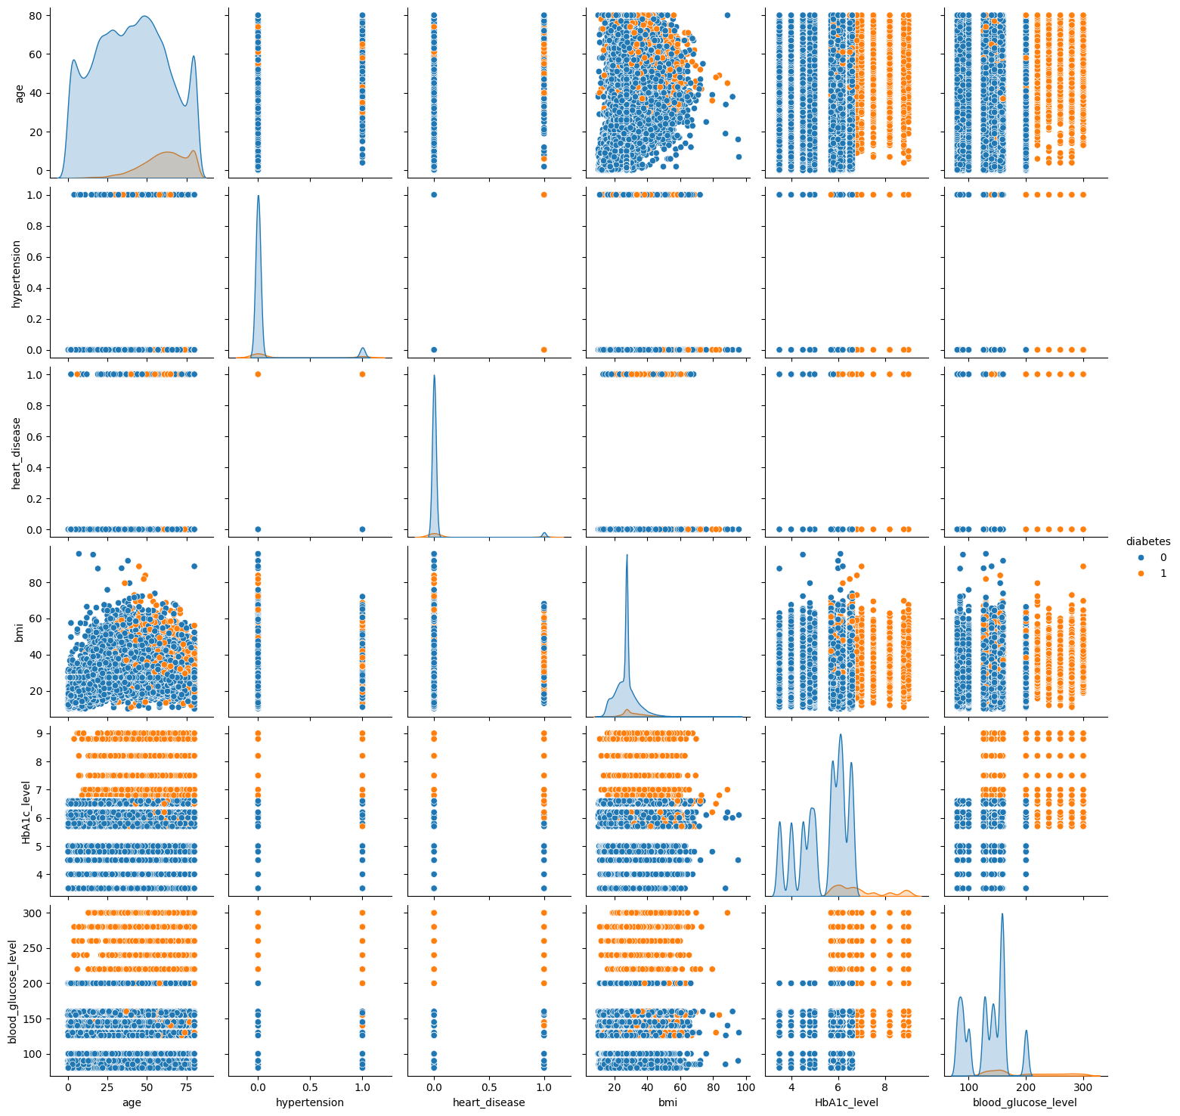
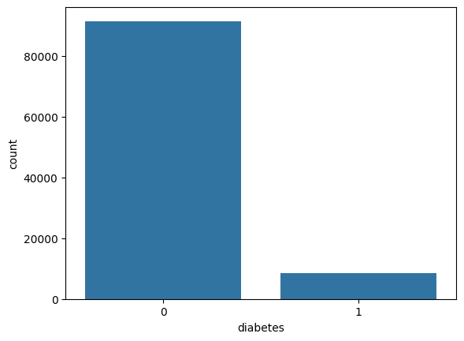
Exploratory Data Analysis

Slide 8
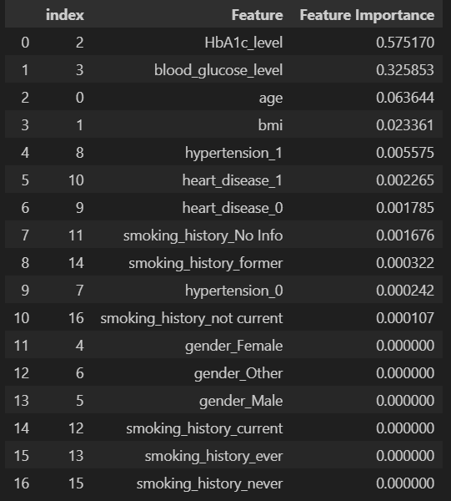
Data Preprocessing and Feature Selection
Data preprocessing: many of the variables involved in this analysis are categorical. These will be encoded as numeric values by the ‘get_dummies’ function available in pandas.
Next, the process of feature selection will be conducted. This process highlights features that do not contribute to the model. They can be removed to increase efficiency and save computational resources.
The general process for feature selection is as follows:
Split the data into X and y
Use tree-based estimators
Run feature importance

Slide 9
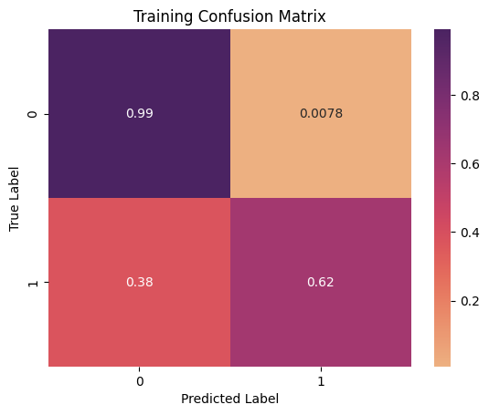
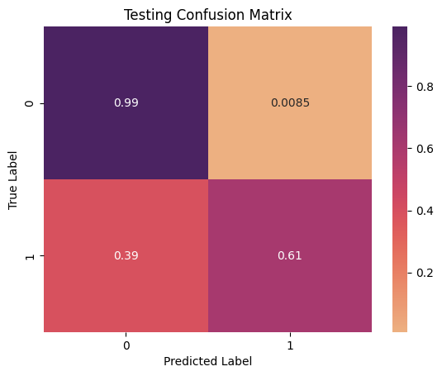
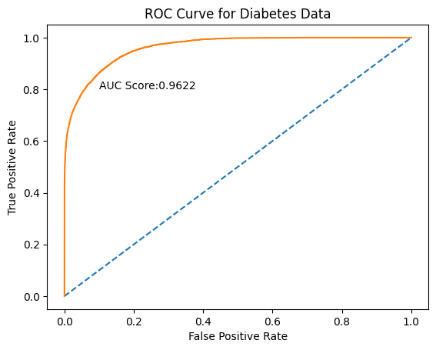
Results - Initial Model Evaluation
Training accuracy: 0.961
Testing Accuracy: 0.959
Evaluation metrics for training data:
True Positive Rate (TPR): 0.97
Precision: 0.99
False Positive Rate: 0.12
False Negative Rate: 0.03
Log loss : 0.11
Area under the curve: 0.962

Slide 10
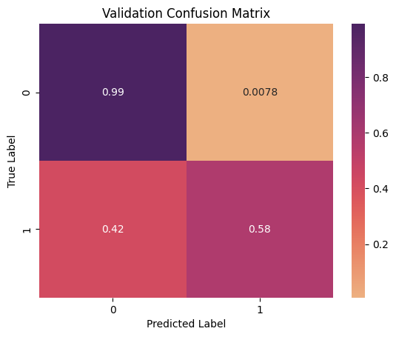
Results - Hyperparameter Tuning
To validate model performance, a hyperparameter ‘C’, the inverse of regularization strength parameter, was introduced to the model.
This parameter was selected using 3-fold cross-validation. The final model was fit using the optimal C-parameter value of 0.546.
While model performance did not see a perceptible increase on the training and testing datasets, it is important to validate the model.

Slide 11


Conclusion
The logistic regression model that was developed provides highly accurate predictions for a diagnosis of diabetes based on clinical measures.
This is a promising tool that can be used by clinicians and healthcare professionals as a supplementary screening measure to detect and diagnose diabetes.
Future directions for a model may provide an even more comprehensive approach to detection.
Notes:
Future directions: sensor activity, movement/exercise, diet.
Different classification models and such.

